Slide 1
Using the Dynamic Brain portal

Slide 2
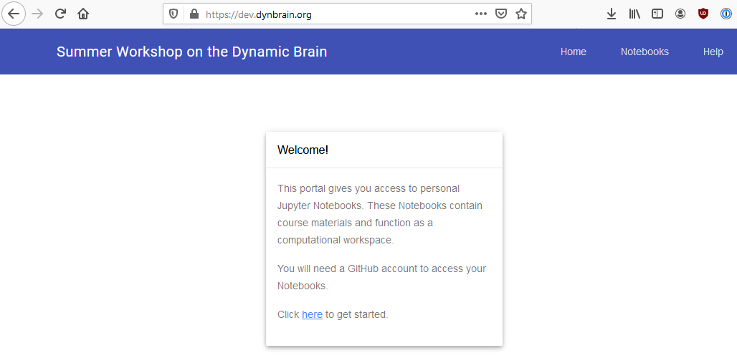
Getting started
Go to: https://dev.dynbrain.org/
You will be greeted with a page that has the following:
Follow the instructions to proceed.

Slide 3
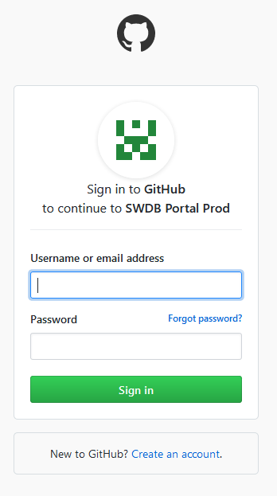
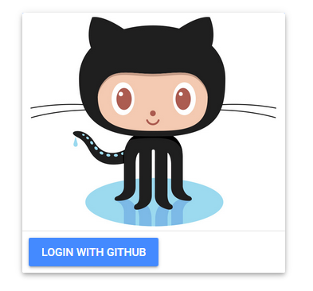
Signing in with github
You will be asked to sign in with Github credentials.
If you don't have a github account, please create one!
You can do so via: https://github.com/join

Slide 4
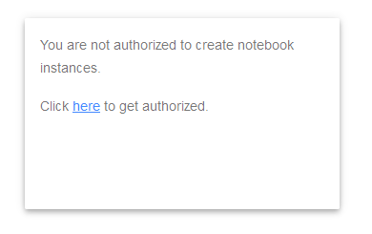
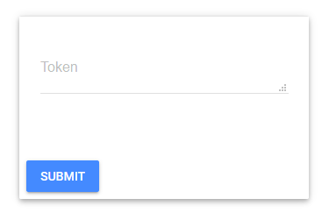
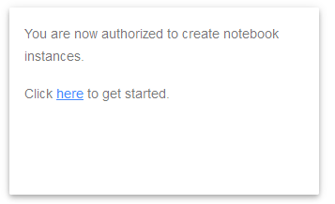
Obtaining notebook creation permission
When you first log in you will be unable to create Jupyter notebook instances.
To gain permissions, you will need to input a "Token", which the instructor will provide.
Tokens have an expiration date. Once they expire you will no longer be able to access or create notebooks!

Slide 5
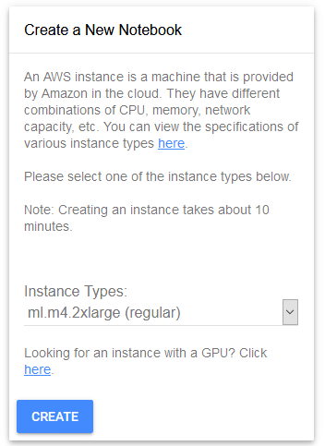
Creating a notebook
Once you have notebook creation permissions you should see a new options page.
Detailed information on the possible instance types can be found:
https://aws.amazon.com/ec2/instance-types/
Creating a notebook can take a while (10-15 minutes) so please be patient!

Slide 6
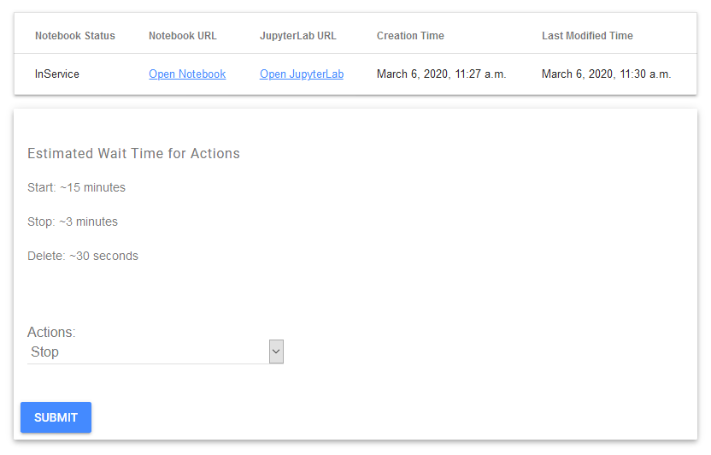
Accessing your notebook
Once created, you can access your notebook by clicking on the "Notebook URL".

Slide 7
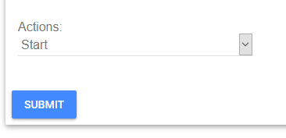
Important notes
When not actively using a notebook for more than a few hours, please make sure to Stop it. This helps ensure costs stay low.
Try to avoid leaving a notebook instance running overnight if your analysis does not require it.
A Stopped notebook can be restarted.

Slide 8
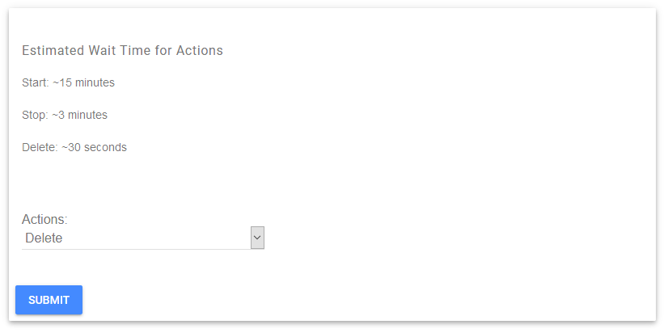
Cleaning up
Make sure to download/save all code you want to keep before the course ends!
When the course ends please make sure to delete stopped notebooks!

